Slide 1
Advance Electronic I
THIRD YEAR
Lecturer: Abbas S.
Hameed
Main References:
1- Robert L. Boylestad and Louis Nashelsky, “ Circuit Theory “.
2- Thomas L. Floyd, “ Electronic
Devices. CCV “.
Electronic
Devices and
3- Adel S. Sedra and Kenneth Carless Smith, “ Microelectronic circuits “.

Slide 2
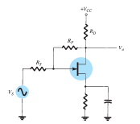
FEEDBACK AMPLIFIERS
Chapter Two Lect 8 Examples

